Slide 1
Director’s Annual Lecture 2020
WiFi: IfG Internet Hotspot |Password: institute123
Bronwen Maddox, Director of the Institute for Government
Chaired by Sir Richard Lambert
@ifgevents #IfGDirector

Slide 2
1. Civil service reform
2. “Levelling up” the UK
3. Brexit, the Union and the constitution

Slide 3
1. Civil service reform

Slide 4
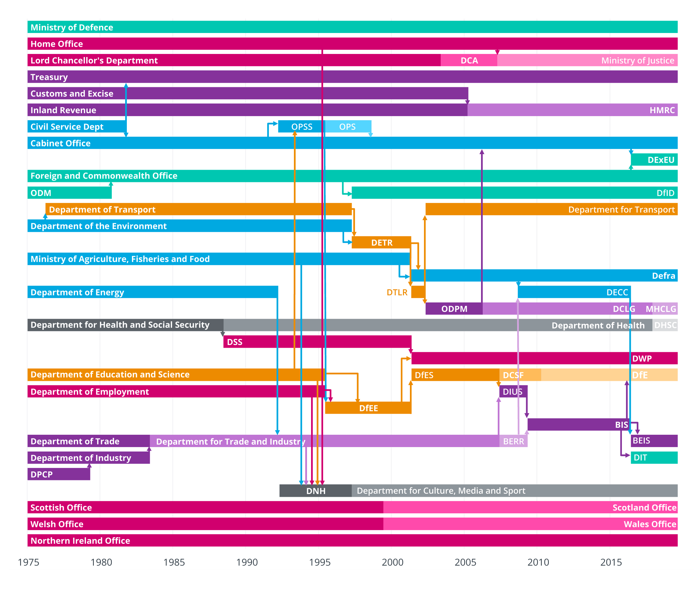
Departmental changes, 1975-2019
Source: IfG analysis of data from House of Commons, and Butler and Butler, British Political Facts.

Slide 5
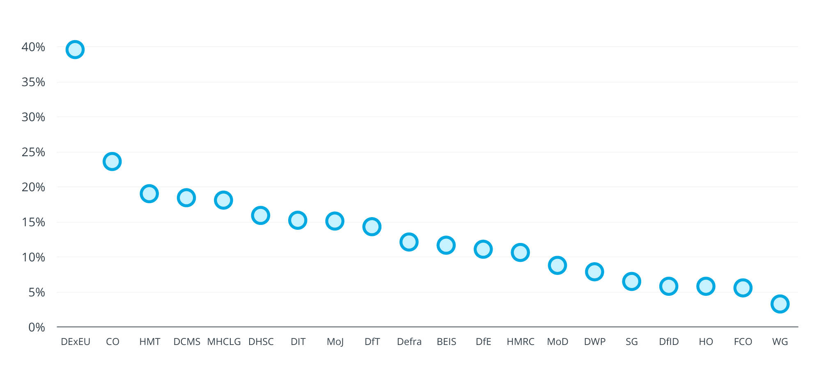
Civil servants leaving departments, 2018/19
Source: IfG analysis of Cabinet Office, Civil Service Statistics; and ONS, Public Sector Employment.

Slide 6
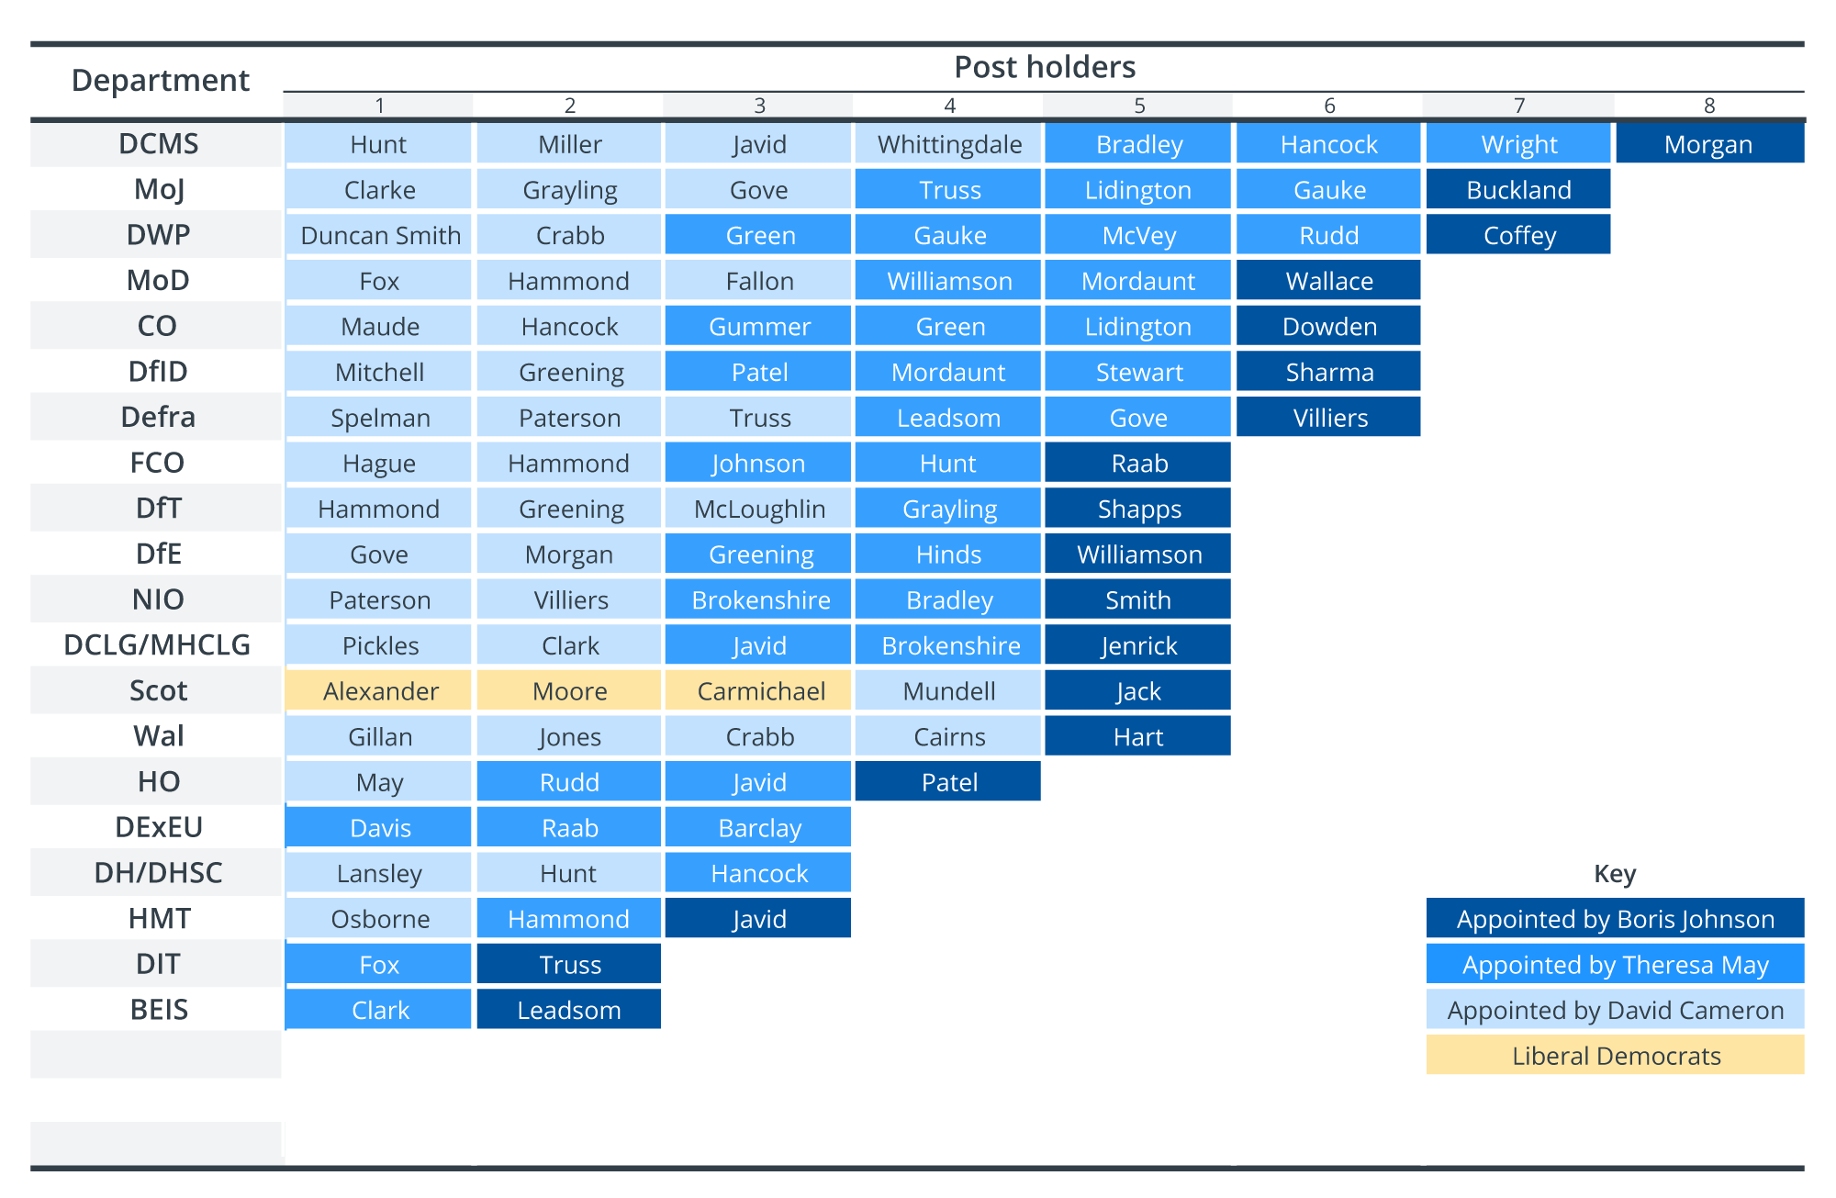
Secretaries of state since 2010
Source: IfG analysis of IfG ministerial database, using sources including GOV.UK/government/ministers.

Slide 7
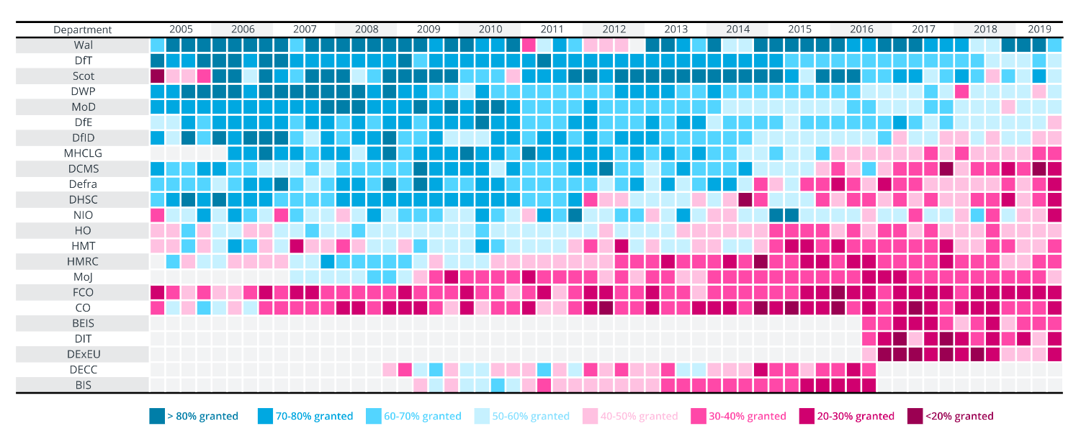
FOI requests granted in full, 2005-19
Source: IfG analysis of Cabinet Office/Ministry of Justice, Government FoI Statistics, Q1 2005 to Q3 2019.

Slide 8
2. “Levelling up” the UK

Slide 9
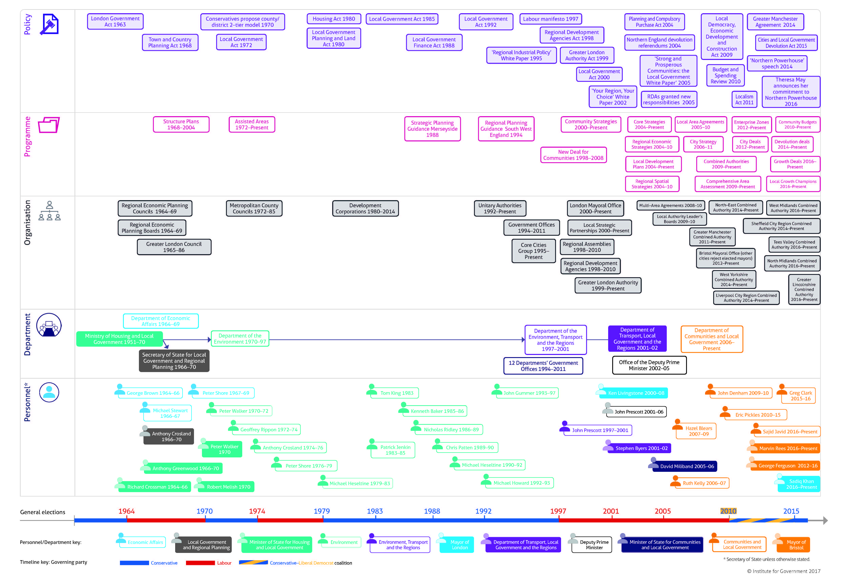
Source: IfG, All Change: Why Britain is so prone to policy reinvention, and what can be done about it, 2017

Slide 10
3. Brexit, the Union and
the constitution

Slide 11
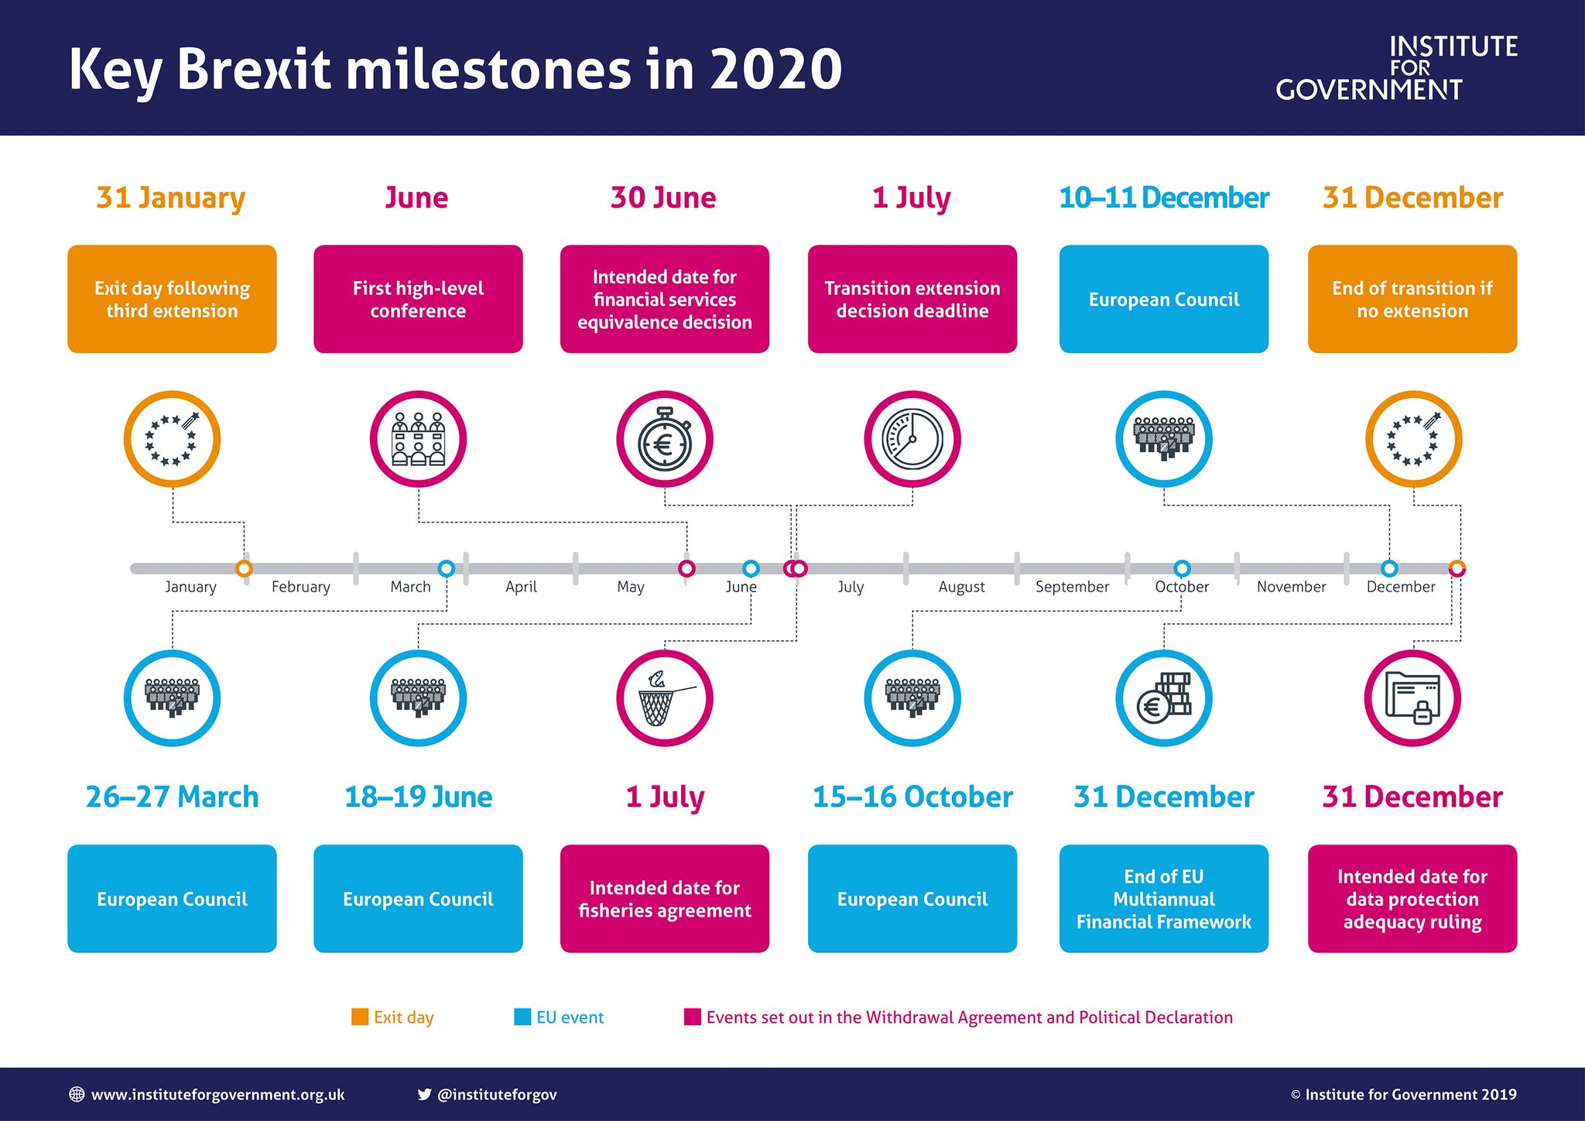

Slide 12
IfG’s work

Slide 13
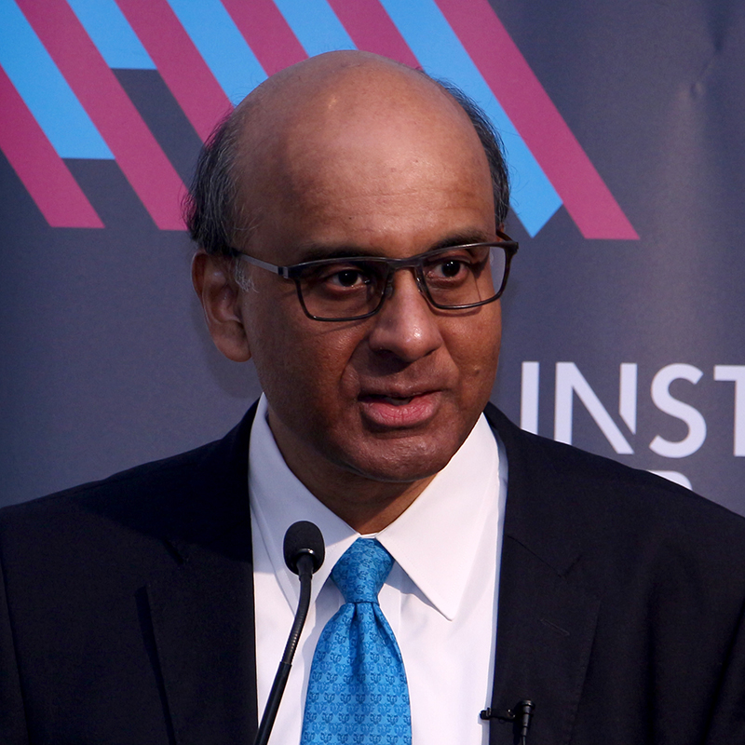
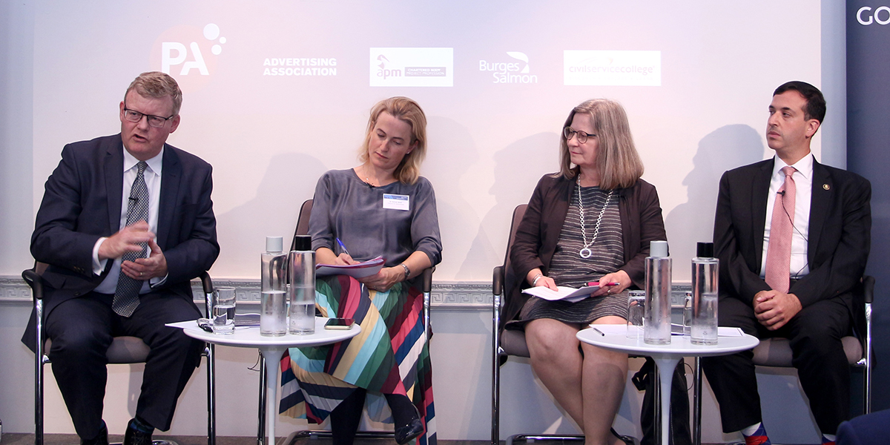
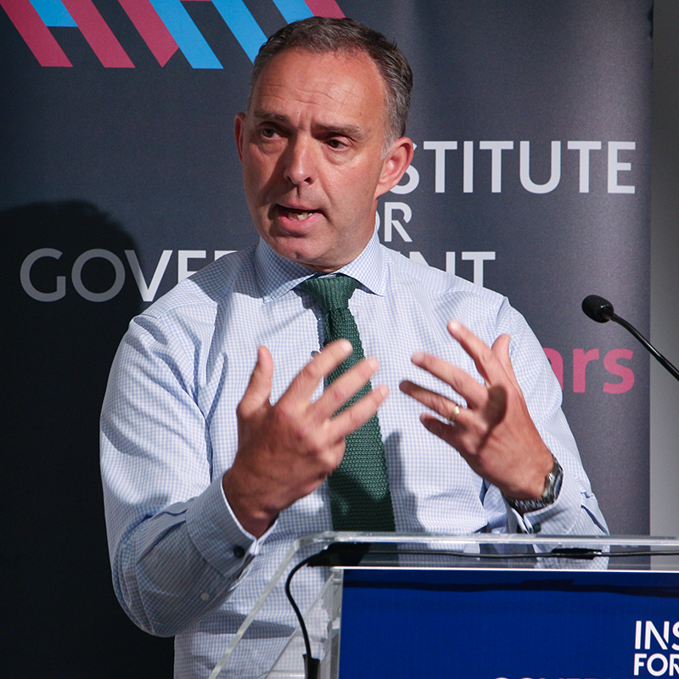
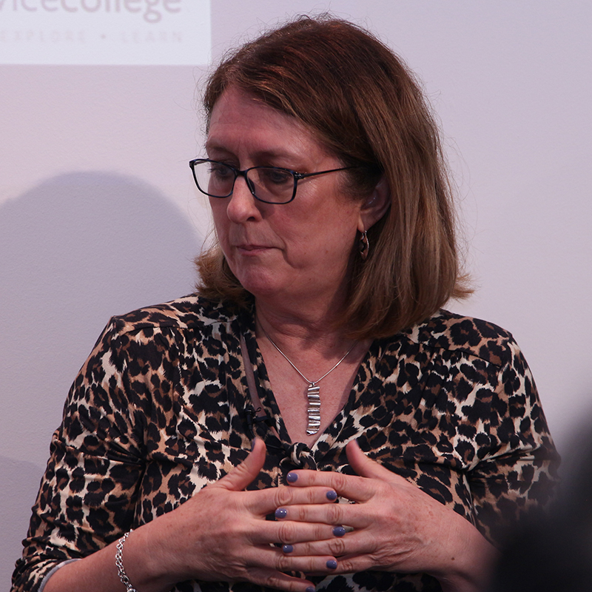
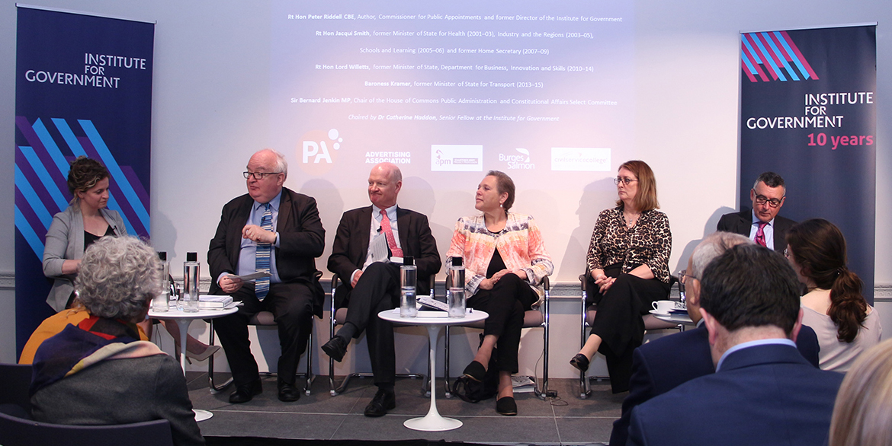
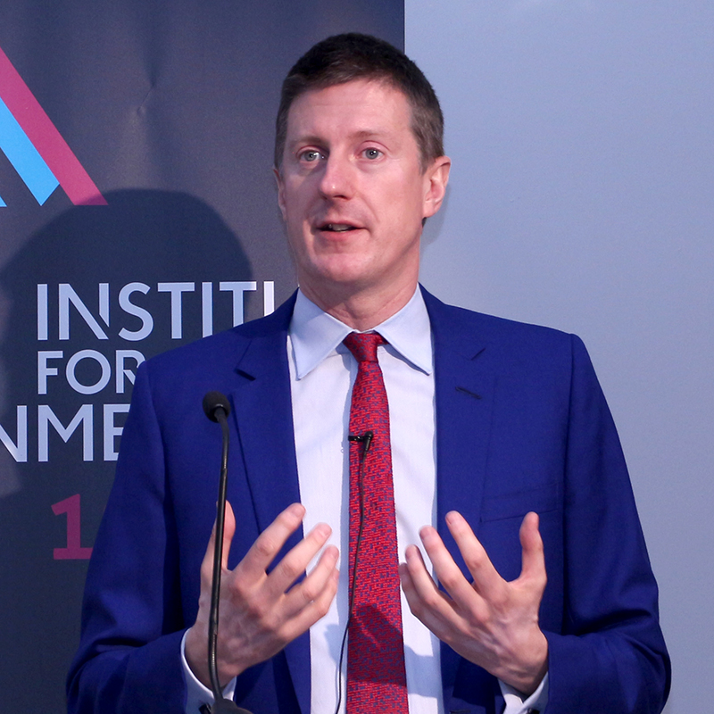

Slide 14
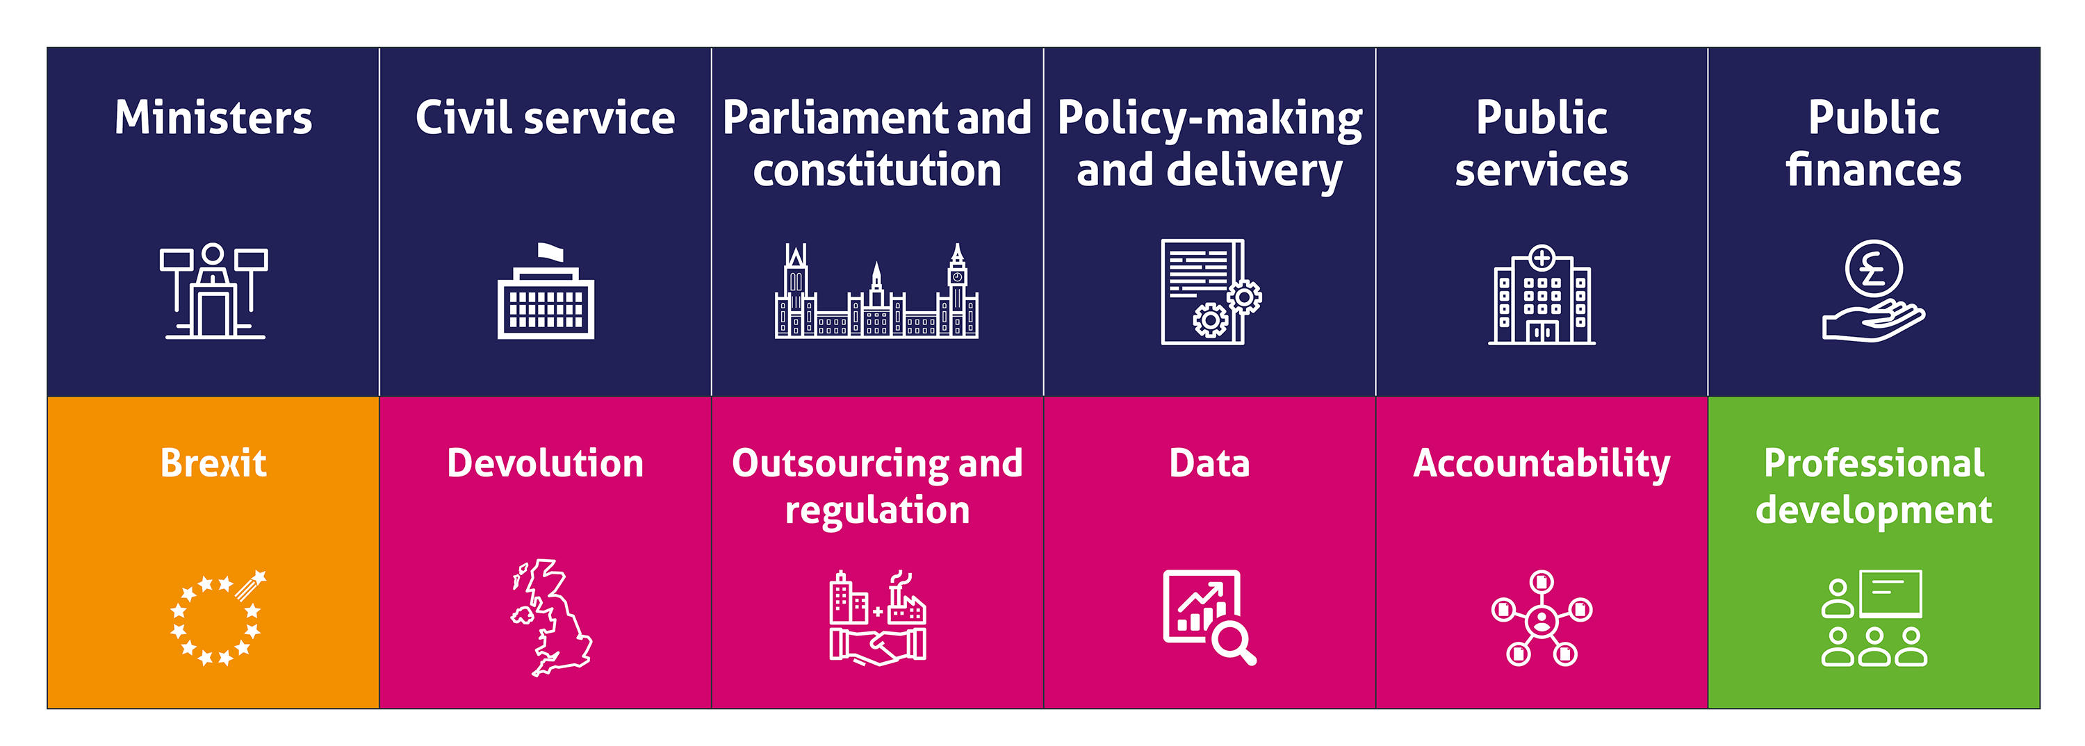
IfG work

Slide 15
Director’s Annual Lecture 2020
WiFi: IfG Internet Hotspot |Password: institute123
Bronwen Maddox, Director of the Institute for Government
Chaired by Sir Richard Lambert
@ifgevents #IfGDirector

